Slide 1

Team 4.02

Slide 2

Team 4.02
05/16/2021
Notes:
The Issue which we wanted to tackle for this project is access and availability to mental healthcare. There are 2 primary issues we plan to address, firstly that there is a stigma associated with mental healthcare and a fear of judgement which causes many people to not seek out the care they need. Secondly there is already an overburden of stress on the healthcare system.

Slide 3
Healthcare Professionals are stressed!
Nearly 1 in 5 U.S. adults live with a mental illness (51.5 million in 2019). (NIH)
Healthcare Professionals are stressed! Now, more than ever.
In 2020 the MHA asked 1119 healthcare workers about what feelings they have been experiencing regularly:
93% - Stress
86% - Anxiety
77% - Frustration
76% - Exhaustion/Burnout
75% - Overwhelmed
Team 4.02
Notes:
Over 50 million people in the US have been identified as having some form of mental health related issue, with these numbers rising even higher in the ongoing and post COVID pandemic era. For this project however we initially want to limit the scope of our core target audience to healthcare workers themselves. Healthcare workers are also in need of mental health care and do also suffer from the associated fear of judgement, with nearly 93% reporting excessive levels of stress. So we feel healthcare workers are a perfect initial audience as they would also be able to provide critical professional feedback on how to improve the solution.
We know that healthcare workers were stressed before the recent pandemic. These feelings have been amplified after the stress of the COVID-19 pandemic that placed intense pressure on all aspects of healthcare.
According to the Mental Health Association, in 2020...(read the percentages on the slide)
Other data if needed -
In 2019, among the 13.1 million adults with serious mental illness, 8.6 million (65.5%) received mental health treatment in the past year.
In 2019, there were an estimated 13.1 million adults aged 18 or older in the United States with SMI. This number represented 5.2% of all U.S. adults.
https://adaa.org/node/5278

Slide 4
Introducing Mentah – The Mental Health Solution for HealthCare Professionals
Our solution brings screening tools and resources to the hand of the Healthcare Professional when they need it most
This interactive application provides more personal and confidential resources
Team 4.02
Notes:
So in order to address this problem, we have developed what we are calling Mentah, a digital solution for mental healthcare with the ability to provide care for users, without the fear of stigma or judgement. We envision this solution as an easy and accessible starting point for anyone's mental healthcare journey.

Slide 5
Mentah Chat Bot
This solution will provide you with an interactive, personal Chat Bot that has the ability to remember and track patterns to enhance cognitive behavioral therapy for individuals.
Cognitive Behavioral Therapy Flowchart:
Journaling
Trigger Identification
Do you feel any of these:
Nervous
Frequent Worry
Restlessness
Feeling ‘On Edge’
Anxious
Panic
Which option would you want to explore today based on your feeling?
Thought Structure
Automatic Thought Identification
Yes
Relaxation Therapy
Meditation
Interested in learning more?
Resource Example:
- Mind Over Matter
- Emotional Alchemy
No
Breathing Technique
Guided Imagery
Team 4.02
Notes:
To actually accomplish this we have developed what is essentially a specialized therapy chatbot capable of understanding the user’s input with a Natural Language processing algorithm paired with the use of a recursive neural network trained on proven clinical methods of Cognitive Behavioral Therapy. We believe that those who may be uncomfortable pursuing traditional methods of mental health therapy would be more open to an automated or digital solution such as this – there is no chance of judgement coming from a machine after all.
The flow chart on the screen is an example of how an individual who could go through the app based on their answers.

Slide 6
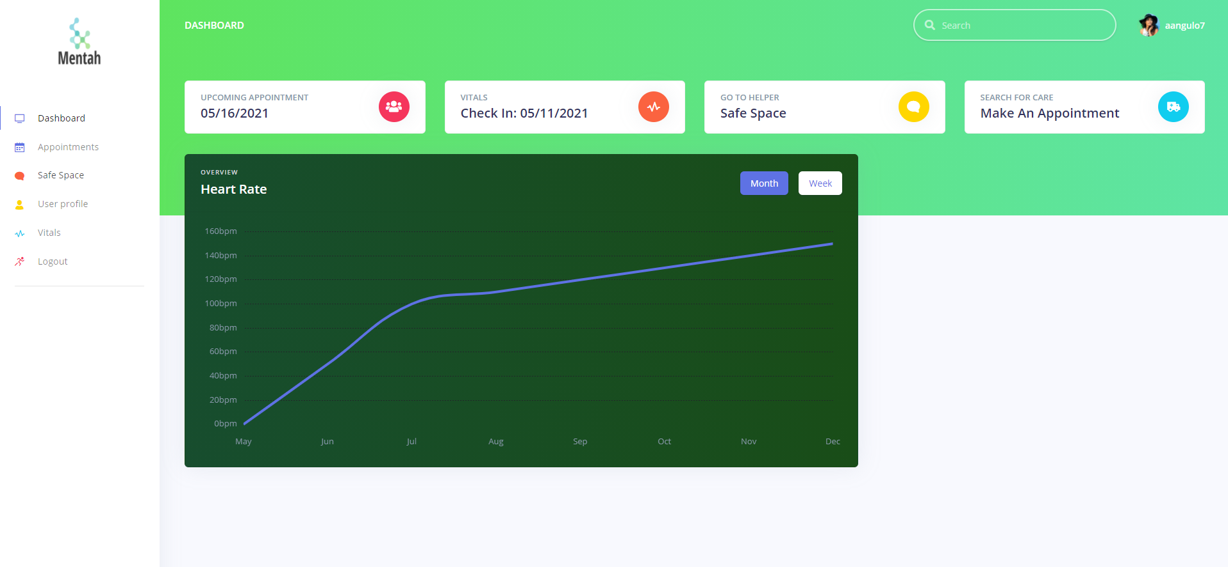
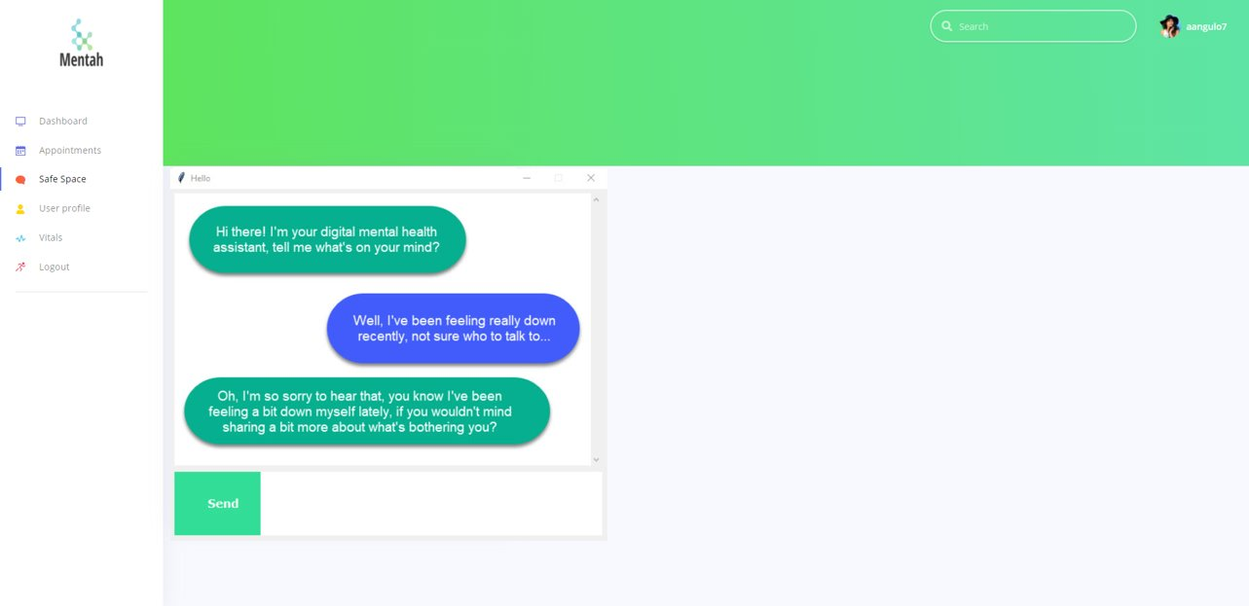
The Mentah Platform
Team 4.02
Notes:
Regarding the current state of the Mentah Platform we have already developed a minimally viable product that has the ability to be deployed as a web or mobile application including the previously mentioned therapy chatbot. Additional modules such as the ability to guide users through the use of CBT concepts such as journaling, meditation, guided imagery, etc. as well as the ability to take voice input from the users instead of just text are to be developed as we go forward with the solution.

Slide 7

Measuring Success
Phase 1
Number of downloads
Number of users
Number of active users
Phase 2
Report of documentation of user self-management goals
Team 4.02
Notes:
So how will we know if this product is successful? Our Phase 1 Success metrics are all about enablement and engagement with users while our Phase 2 Success metrics are more about user benefit and effectiveness of care provided, or patient outlook.
This population-based measure is used in primary care settings to assess the percent of patients with a diagnosis of depression with documented self-management goals set within the last 12 months.Patient education and self-management skills have been important components of collaborative model interventions (Katon W, et al., JAMA 1995; Olivarius N, et al., BMJ. 2001; Renders CM, et al., Diabetes Care. 2001; Norris SL, et al., Diabetes Care. 2001; Maly RM, et al., Jrnl Amer Ger Soc 2002; Heisler M, et al., J Gen Inter Med 2002; Lorig KR, et al., Medical Care 1999).

Slide 8

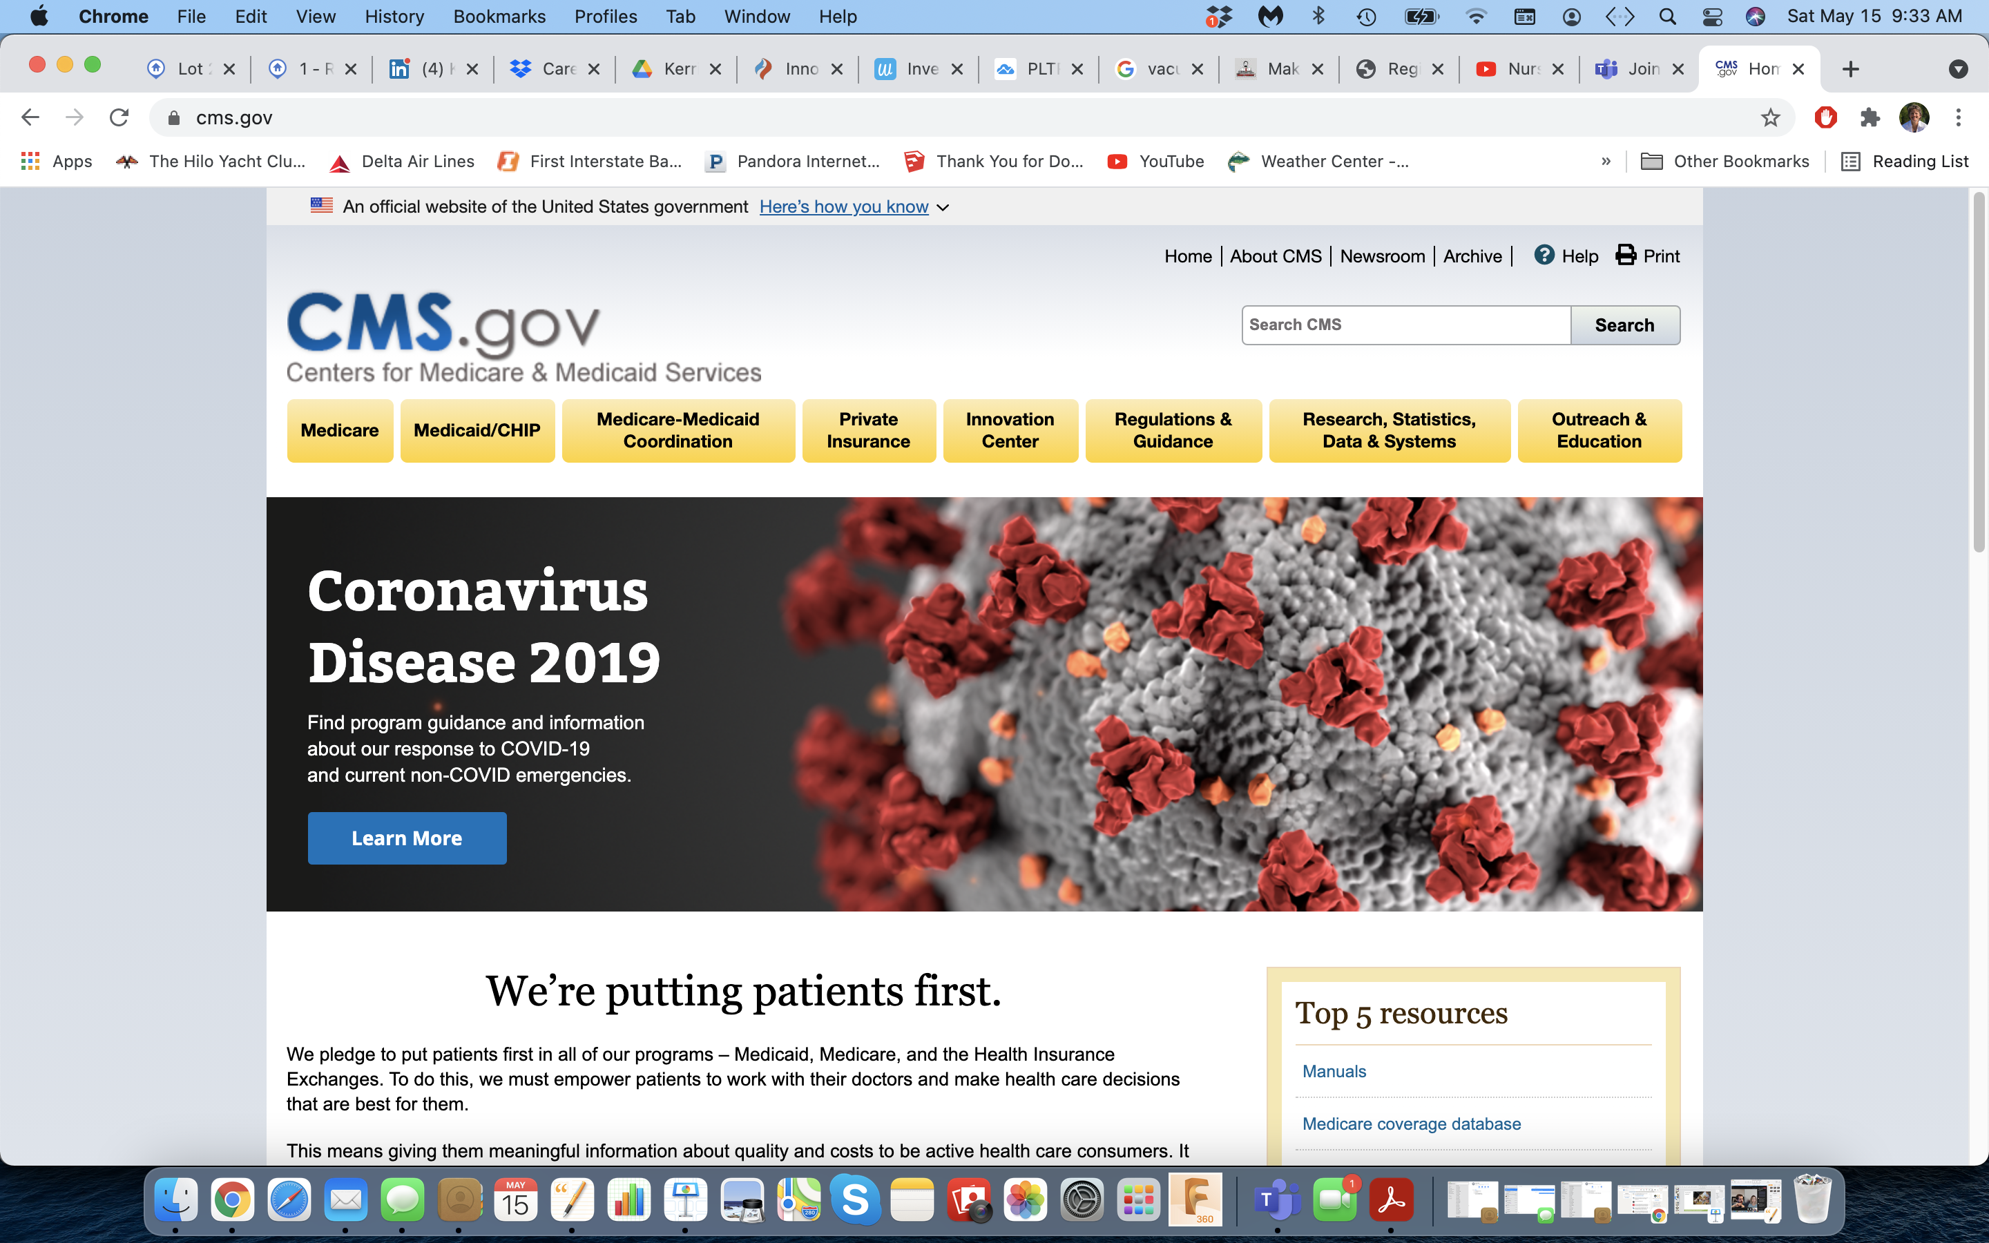
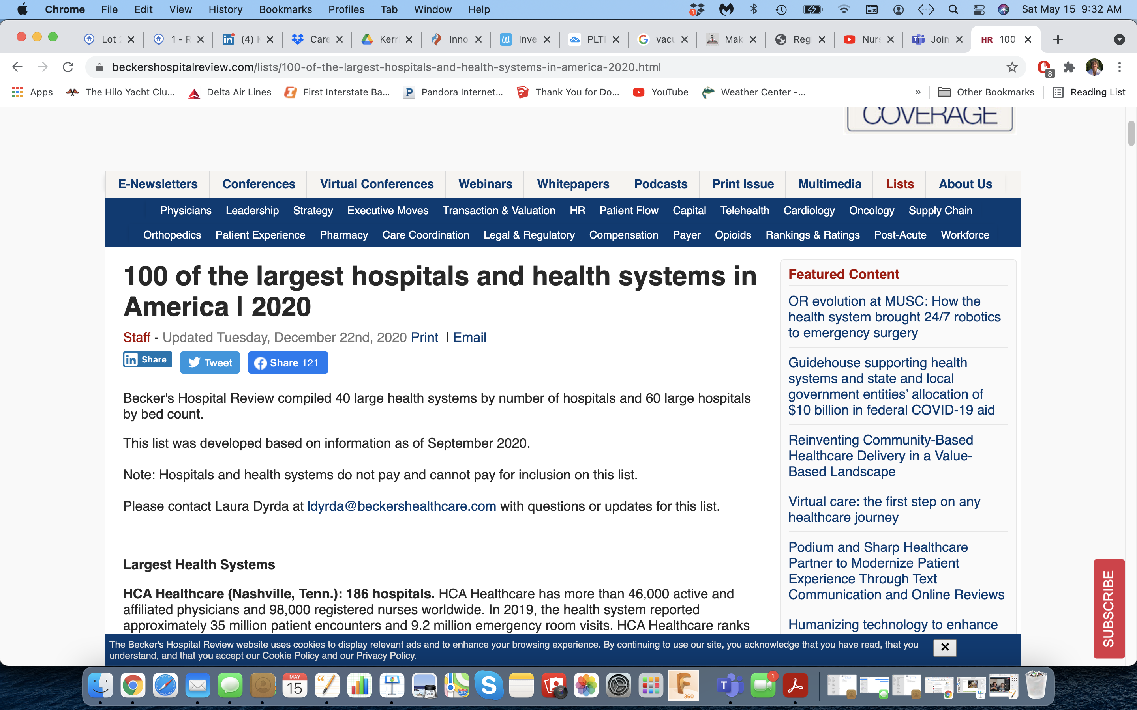
Target Market and Monetization
Initial Target Market:
Health Care Professionals
Investment in self-care begins with
Healthcare Professionals
Payors include:
Free for consumers
ACO to improve care management and reduce hospital use
Team 4.02
Notes:
So as mentioned our initial target market are healthcare professionals with the benefits to hospitals being the healthcare workers ability to provide better standard of care when their own mental health concerns are being addressed as well as lower costs associated with less burnout and exhaustion.

Slide 9
Scalability
Healthcare
Professionals
Healthcare
Touchpoints
Worldwide
Community
Team 4.02
Notes:
However, we do of course see great potential after the initial phases to scale up the userbase beyond healthcare professionals into the general population at large.

Slide 10
What questions do you have?
Team 4.02
Notes:
We do also have a website which functions as essentially a digital pamphlet focused on the ideas and vision which we see for the future of Mentah.

Slide 11
References
Greenberger, D. and Padesky, C. A. (1995). Mind Over Mood: Change How You Feel by Changing the way You Think. The Guildford Press.
Bennett-Goleman, T. (2001). Emotional Alchemy: How the Mind Can Heal the Heart. Three Rivers Press.
NIH - https://www.nami.org/mhstats
https://mhanational.org/mental-health-healthcare-workers-covid-19#:~:text=The%20responses%20collected%20from%20the,75%25%20said%20they%20were%20overwhelmed
https://www.census.gov/library/stories/2020/10/health-care-still-largest-united-states-employer.html#:~:text=According%20to%20the%20U.S.%20Census,in%20annual%20payroll%20in%202018.
Team 4.02

Slide 12
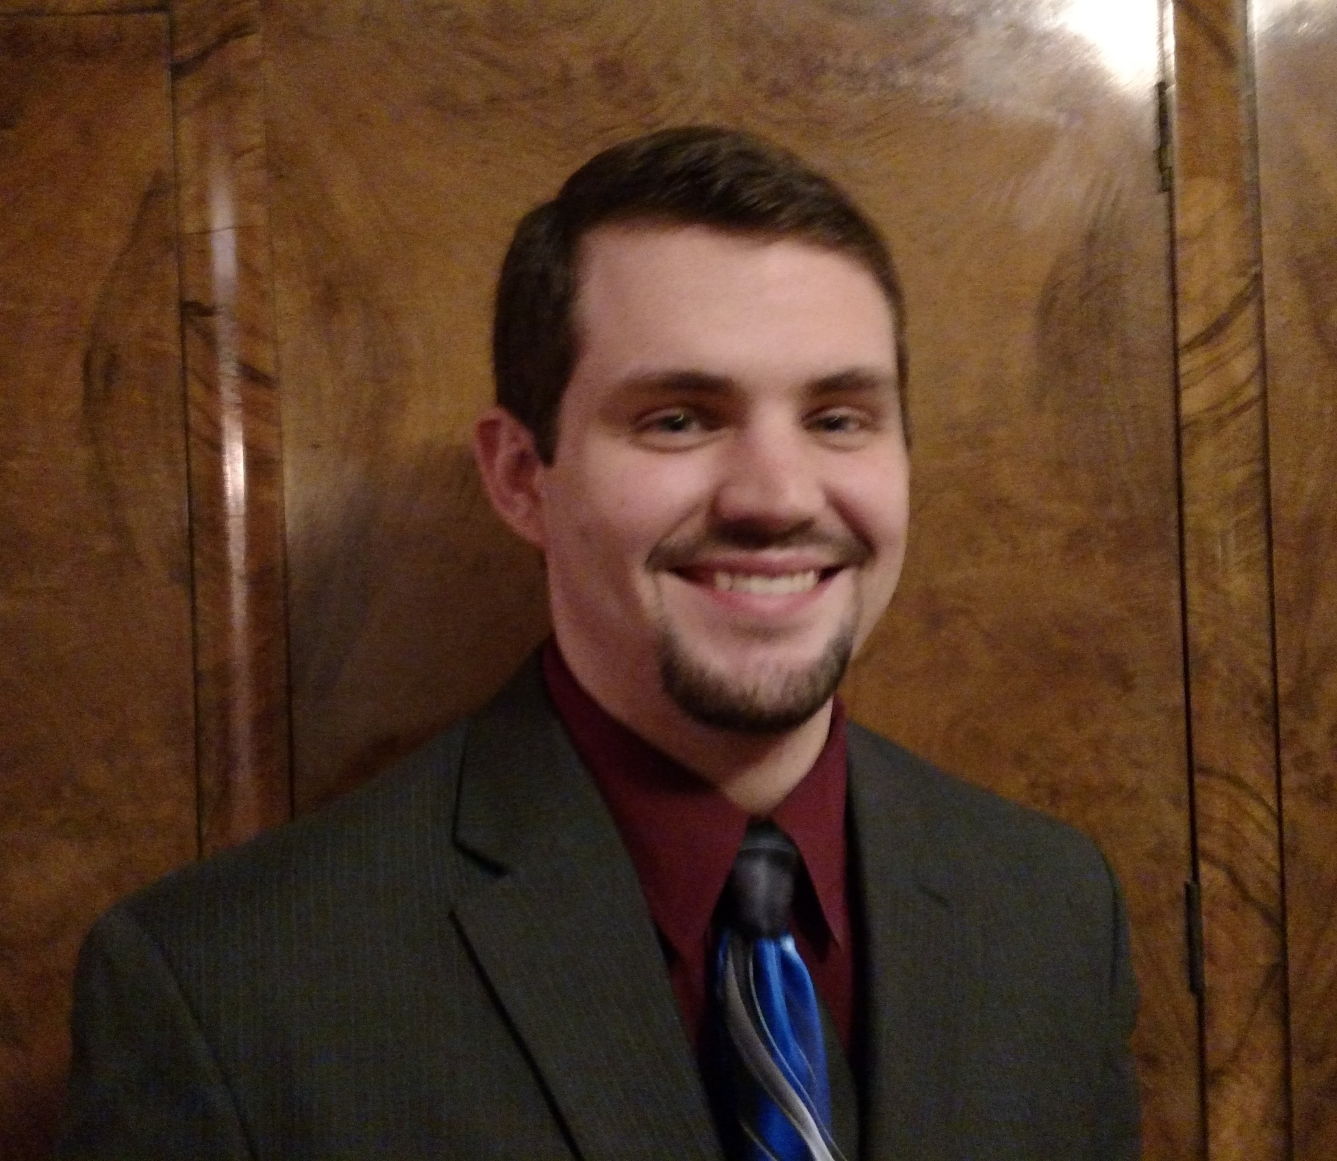


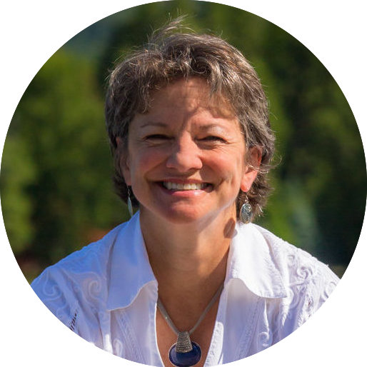
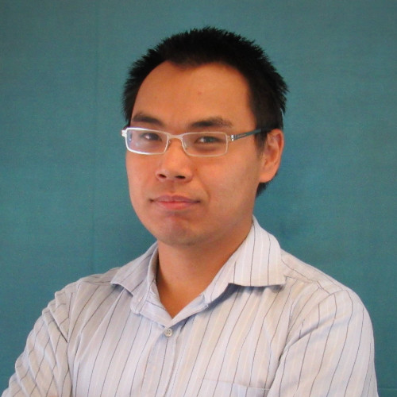

The Team
Trevor Greer is a Digital Cloud Solution Architect with a personal passion for developing solutions to complex issues and ideas.
Kristi Reguin-Hartman is an advanced practice nurse and product manager who believes when you support healthcare providers, everyone benefits.
Linda Anders is a master prepared registered nurse with a bold approach to impact healthcare around the globe.
Kerrie Cardon is a former EMT, registered nurse, healthcare architect & passionate about innovation.
Ben Zheng is supply chain at Johnsons & Johnsons, working to bring products safely to our customers across the globe.
Alejandra Rico is a Cloud Solution Architect inspired by technology, especially AI field also obsessed with health and healthcare and helping people in this field.
Detailed biographies to follow
Team 4.02

Slide 13
Trevor Greer
Digital Cloud Solution Architect @Microsoft
Trevor is a Digital Cloud Solutions Architect at Microsoft and has a personal passion for developing solutions to complex issues and ideas. He has a bachelor's degree in Electrical Engineering and Industry Experience in developing and deploying customer monitoring/data solutions.
Team 4.02

Slide 14

Alejandra Rico
Cloud Solution Architect in Data & AI for Healthcare @Microsoft
In the past years, Alejandra was working with various cloud Open Source technologies at Microsoft. She has a Bachelor degree in Biomedical Engineering and is currently pursuing a Masters in Machine Learning at Georgia Tech University.
Team 4.02

Slide 15

Ben Zheng
SAP Supply Chain Engineer, J&J VisionCare
In the past year, Ben is working in supply chain at J&J VisionCare. Prior, he worked in Allergan and Cardinal Health implementing technology solutions for R&D ranging from business intelligence solutions to quality control instrumentations. He has a Bachelor degree in Chemical Biology and Economics from UC Berkeley.
Team 4.02

Slide 16
Linda Anders, MBA, MSN, RN, CSRN, NPD-BC
Nursing Education Programming Manager, Sigma Theta Tau International
Board certified in Nursing Professional Development; Linda is an established nurse with a global mindset. Currently enrolled in a Doctor of Nursing Practice program with a minor in Nursing Leadership and Innovation along with a graduate certificate in Global Public Health, Linda jumped at the opportunity to participate in this #NurseHack4Health.
Team 4.02

Slide 17
Kristi Reguin-Hartman, MSN, APRN, ACNS-BC
Product Manager & Clinical Nurse Specialist
Kristi is a Senior Product Manager for Acute Care Learning at Relias and faculty in the Department of Advanced Practice Nursing at East Carolina University. She volunteers as a National Director for the Academy of Medical Surgical Nurses and for her local public health department as a Covid vaccinator.
Team 4.02

Slide 18

Kerrie Cardon, BSN, RN, RA
Chief Innovation Officer @ Bison Creek Innovations
A former EMT and Registered Nurse, Kerrie's years in healthcare inspired a devotion to the planning and design of safe, efficient and healing environments as a Healthcare Architect. Her integration of medical knowledge with architecture supports the user experience and enhances human-centered care. Kerrie’s career trajectory has culminated in her passion for innovation, inventing and product development.
Team 4.02

Slide 19
Thank you
Team 4.02

Slide 20
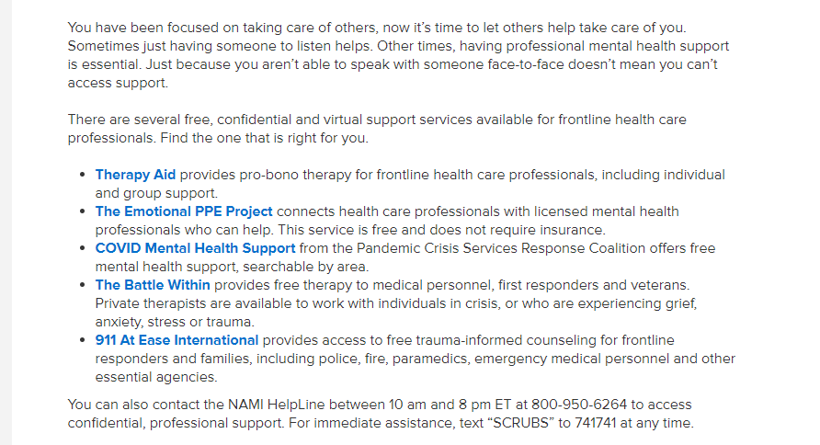

Currently Available Solutions
Current Solutions -
While resources specific to healthcare providers do exist – the are hard to find and often embedded in lists of websites and resources
https://www.nami.org/Your-Journey/Frontline-Professionals/Health-Care-Professionals

Slide 21
Our Solution vs. The Competition
Benefits | Our Solution | BetterHelp | Pathways | Moodfit
Users | Specific to HCPs | OPs | OPs | OPs
Intuitive to Use | X | X | X | X
Cost to Use | Free | Pay per Visit | Pay per Visit | 30 days Free
Platform | Apple/Android | Telehealth | Telehealth | Apple/Android
Chat Bot | X
Self-Navigation | X |  |  | X
Notes:
This is a comparison chart for our solution verse what is one the market today.

Slide 22
Our Solution vs. The Competition
Benefits | Our Solution | BetterHelp | Pathways | Moodfit
Intuitive Design
Cost
Performance
Self Navigation
Chat Bot
Overall Assessment | 5 | 2 | 2 | 4

Slide 23
Implementation Cost (kc duplicated this slide)
Although we don’t expect a full business plan, your team should think about implementation cost and who is going to pay for the solution.
Will it be the patient? Insurance Company? Hospital system etc. Thinking it will be private insurers, health systems and government (CMS). I will revise this slide in next slide.
Try to understand your costs to build your solution, which will in turn, inform you of what the costs will need to be. (Trevor?)
How will you penetrate the market? Who are the key market influencers/decision makers that you need to target or consider? Penetrate through healthcare providers including front line clinical staff; subscription service; part of clinical staff self-care service

Slide 24
Scalability – kc duplicated this slide
When devising a solution, you should always think about your target population and give it some thought as to how the solution can be scaled and implemented everywhere not just at your institution( this can happen later, of course, but be prepared to answer the question).
Are there other case uses for your solution?
What do you need to be successful?
Who else needs to be involved to implement your solution?

Slide 25
The Team & Close – kc duplicated this slide
Bring the story you opened with full circle.
Close the pitch– why do you think this is a great idea? Remind the audience what they have seen – no more than three points.
Introduce your team members and discuss skill sets brought to the team that strengthens the solution. By now the audience understands your proposed solution so they can connect the skill sets. Include contact Info: Name/Email
Many investors will invest if they like the team and find the team inspiring and passionate.
Try to anticipate the judges questions so you can answer them, however, if you have done your homework, you will be prepared.
Finally, practice, practice, practice! Getting all important points across in 3 minutes!

